Slide 1
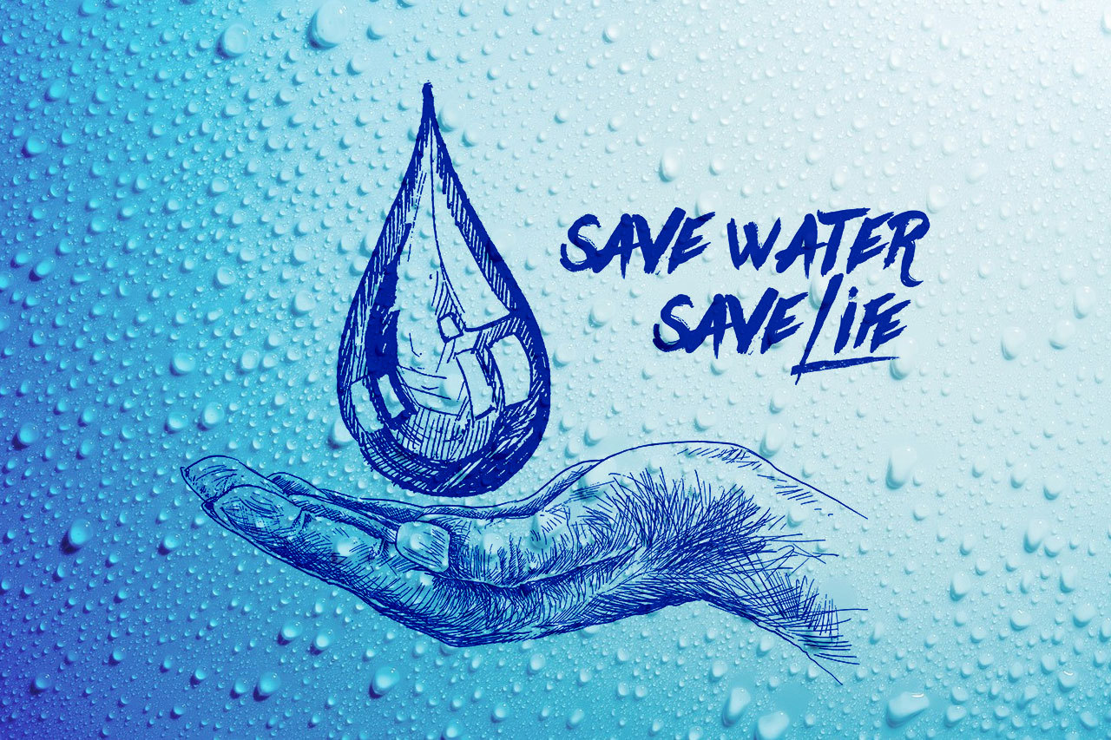
“Every Drop Counts”
Name: Supriya
Trade: AIPA
Institute: NSTI(W)

Slide 2
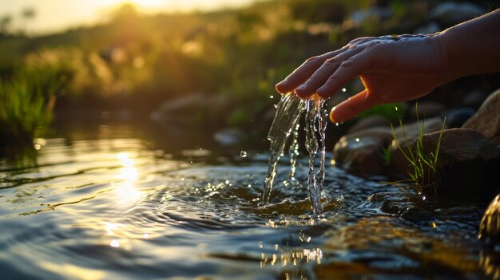
Importance of Water
Water is essential for human life.
It is necessary for drinking, cooking and hygiene.
Plants and animals depend on water for survival.
Water is important for agriculture and food production.
Industries also require water for various processes.
Clean water is essential for a healthy environment.

Slide 3
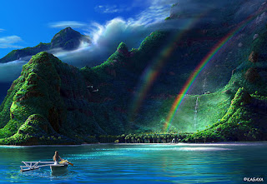
Current Water Challenges
Water scarcity in many regions
Groundwater levels are decreasing
Pollution of rivers, lakes and ponds
Unequal access to clean drinking water
Increasing demand due to population growth
Climate change affecting rainfall patterns

Slide 4
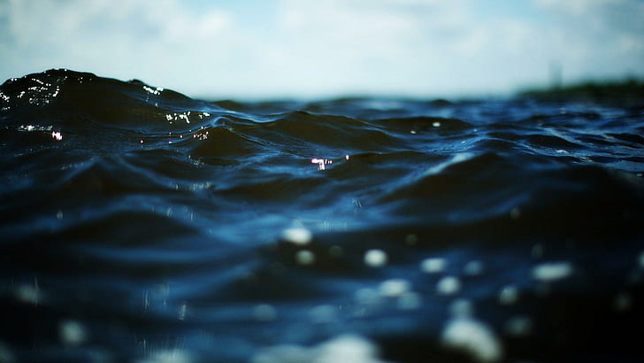
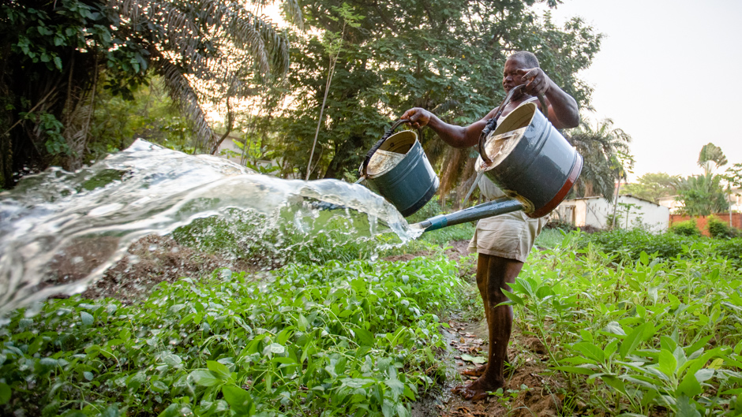
Major Causes of Water Wastage
Leaving taps running
Leaking pipes and taps
Excessive use of water
Flood irrigation
Unnecessary washing of vehicles
Poor rainwater management
Water pollution
Leakage
Poor Management
Water Wastage
Excessive Use
This Photo by Unknown Author is licensed under CC BY-ND

Slide 5
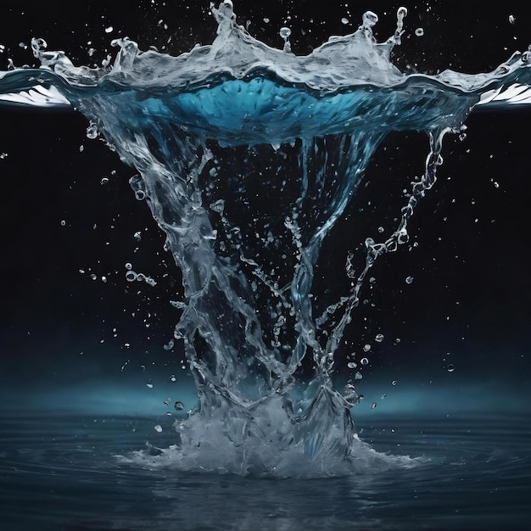
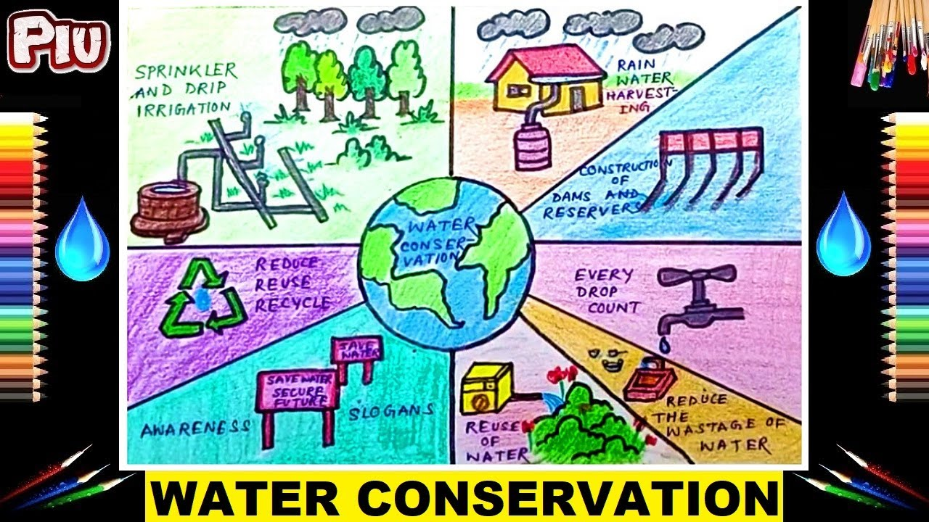
Water Conservation Methods
💧 Save
🔄 Reuse
🌧️ Harvest
🌱 Protect
♻️ Recycle
Rainwater harvesting
Reuse and recycling of water
Fixing leaks
Drip irrigation
Water-efficient appliances
Protecting rivers and lakes
Reducing water pollution

Slide 6
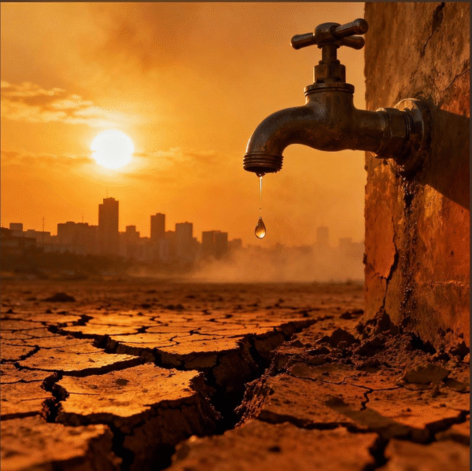
Water Conservation at Home
Turn off taps when not in use.
Repair leaking taps and pipes.
Take shorter showers.
Reuse water whenever possible.
Use a bucket instead of a hose for washing.
Run washing machines only with full loads.
Collect rainwater for gardening.

Slide 7
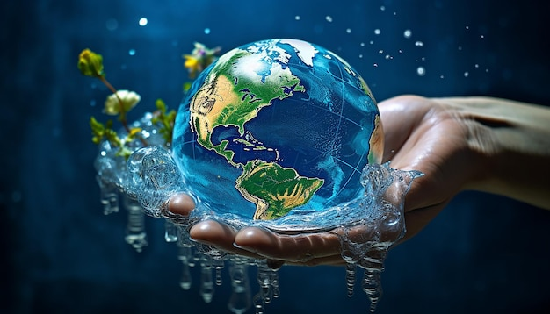
Water Conservation in Agriculture
Use drip irrigation.
Use sprinkler irrigation where suitable.
Practice rainwater harvesting.
Grow crops suitable for local conditions.
Avoid over-irrigation.
Maintain soil moisture through mulching.
Use efficient irrigation schedules.

Slide 8

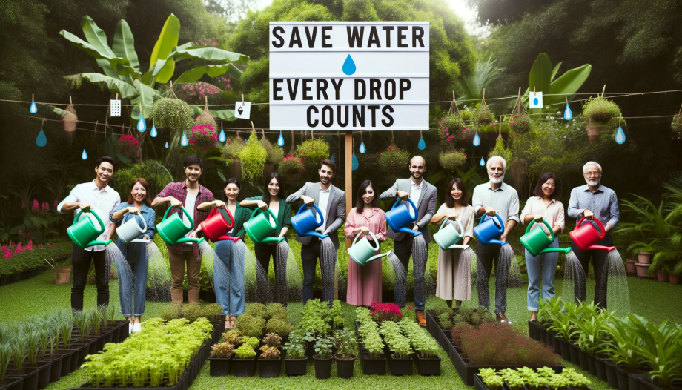
Role of Students
Turn off taps properly.
Report leaking taps and pipes.
Avoid wasting drinking water.
Spread awareness among friends and family.
Participate in cleanliness drives.
Promote rainwater harvesting.
Encourage others to save water.

Slide 9
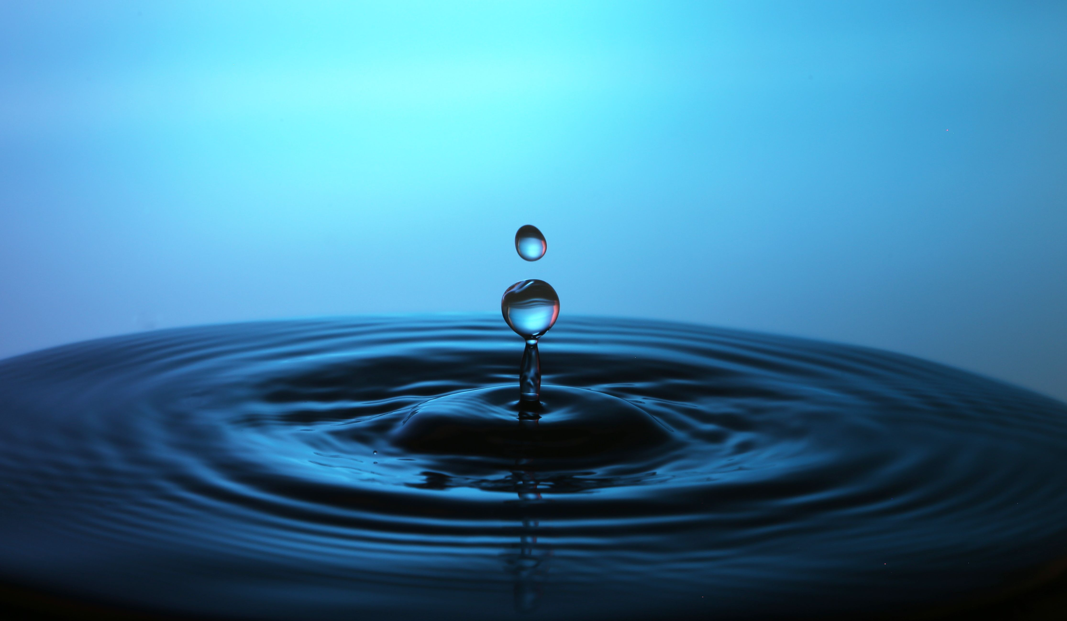
Do's and Don'ts
DO's | DON'Ts
Turn off unused taps | Don't leave taps running
Fix water leaks | Don't ignore leaking pipes
Reuse water where possible | Don't waste clean water
Use water-efficient methods | Don't overuse water
Harvest rainwater | Don't pollute water sources

Slide 10

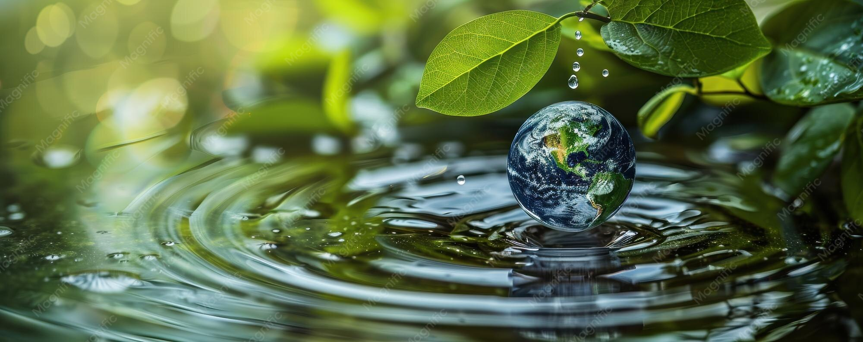
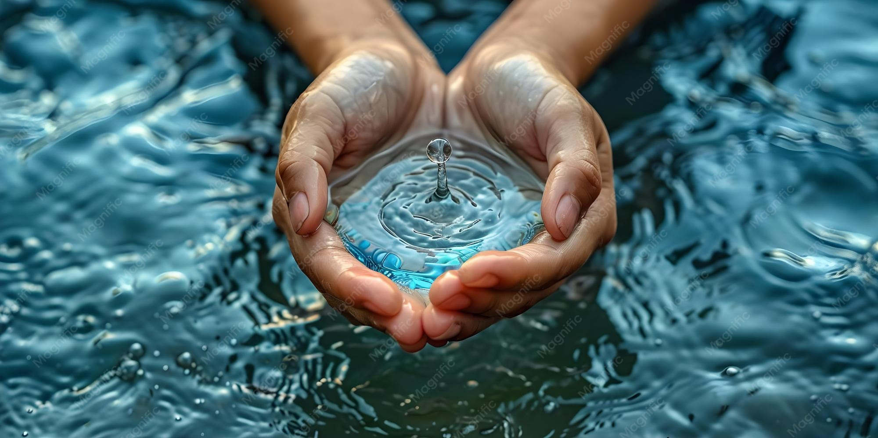
Conclusion
💧 Water is Life — Save Every Drop!
Water is essential for all living beings.
Water wastage should be reduced in our daily lives.
Everyone can contribute to water conservation.
Small steps today can protect water for future generations.
“Save Water, Save Life, Save Our Future! ”

Slide 11


